Slide 1

Fabric Admin 101
Settings, Tools, and Monitoring that Keep the Lights On and the Bills Down
Come up front for some stickers ☺
Kristyna Ferris
Fun Fact: this font is dyslexic friendly! Ask me how to use it for free after the session.
Notes:
Top 10 Dyslexia-Friendly Fonts for 2026 | TypeSmith | TypeSmith
Download the font from Atkinson Hyperlegible - Google Fonts
Extract the files
Go to computer settings > personalization > fonts and drop in the files
Navigate to Power Point Master Slide
Change the font to use Open Dyslexic for the headers and body
Done!

Slide 2









Thank you to our sponsors
★ HEADLINER ★
MAIN STAGE
SUPPORTING ACTS
Notes:
Please leave this slide in and give our sponsors a shout-out. They make PNW Day of Data free for everyone.

Slide 3

About Me ~ Kristyna Ferris
Microsoft MVP, Data Platform & Fabric
Solution Architect, P3 Adaptive
Lexington Data Tech Group co-organizer
DataOnWheels Author
Blog
https://dataonwheels.wordpress.com/
LinkedIn
https://www.linkedin.com/in/kristyna-ferris-dataonwheels/
Twitter & Bluesky
@data_dragoness

Slide 4
My Least Favorite “Oh No” Moments
2023: F64 capacity hit 6k% capacity usage in two hours
2025: F128 capacity with 8k workspaces frequently, but irregularly, spiked with interactive utilization
2026: Post load balancing, had an executive reporting capacity get taken down by a new dataflow that took 6 hours to run

Slide 5

Let’s go from

Slide 6

To

Slide 7



The Realm Defender’s Path
TORCHBEARER
SWORN DEFENDER
REALM PROTECTOR
"You can finally see
what's in the dark"
"Armed, trained, and
holding the line"
"You fireproof the village
before the dragon arrives"
Tenant settings that matter
Admin portal orientation
Capacity settings
Capacity Metrics App
FUAM activity monitoring
Community tools
Notebook guardrails
Capacity data capture
Proactive cost control

Slide 8
Light the Torch
TORCHBEARER
There are 171 tenant settings with new ones being added/updated daily.
Don’t recommend making a SCD type 2 table of this by the way, it will only drive you crazy with how often these descriptions and names are changed.
Thankfully, there is a site where you can get up-to-date information about the settings available.
We’ll cover a few of the first settings I set up.
Notes:
Tenant Setting Index: Tenant settings index - Microsoft Fabric | Microsoft Learn
Easier to grab via the markdown file (click the three dots next to the title on the page then hit copy markdown)

Slide 9
Critical Security Settings
TORCHBEARER
Publish to web – disable! Trust me, you don’t need this
Guest users can access Microsoft Fabric – disable or restrict
Users can invite guest users to collaborate through item sharing and permissions – disable or restrict
External data sharing – disable
Allow shareable links to grant access to everyone in the org – disable
Users can send email subscriptions to external users - disable
Notes:
Tenant Setting Index: Tenant settings index - Microsoft Fabric | Microsoft Learn
Easier to grab via the markdown file (click the three dots next to the title on the page then hit copy markdown)

Slide 10
Critical Governance Settings 1
TORCHBEARER
Users can create Fabric Items – limit to security groups. This one saves you from worrying about a ton of little settings
Export to Excel – limit to security groups if possible
Service principals can call Fabric public APIS – limit to security groups
Notes:
Tenant Setting Index: Tenant settings index - Microsoft Fabric | Microsoft Learn
Easier to grab via the markdown file (click the three dots next to the title on the page then hit copy markdown)

Slide 11
Critical Governance Settings 2
TORCHBEARER
Create workspaces – limit to security groups
Users can try Microsoft Fabric paid features. Turn this off unless you want people to spin up trial capacities.
Users can use copilot and other features powered by Azure OpenAI. Restrict this to specific groups until you know your capacity impact
Notes:
Tenant Setting Index: Tenant settings index - Microsoft Fabric | Microsoft Learn
Easier to grab via the markdown file (click the three dots next to the title on the page then hit copy markdown)

Slide 12
Quality of Life
TORCHBEARER
Users are alerted to upcoming conferences – disable
Define workspace retention period - enable. Allows you to extend the soft-delete window beyond 7 days to recover accidentally deleted workspaces
Fabric item recovery – enable
Product Feedback – disable
All Power BI users can see “Set Alert” button to create Fabric Activator alerts – disable
Receive email and Teams notifications for service outages or incidents – enable for mail-enabled security groups
Notes:
Tenant Setting Index: Tenant settings index - Microsoft Fabric | Microsoft Learn
Easier to grab via the markdown file (click the three dots next to the title on the page then hit copy markdown)

Slide 13
Capacity Settings
TORCHBEARER
Set up notifications on capacity usage
Set up surge protection
Set up capacity overage
Set certain workspaces as mission critical

Slide 14
Your Capacity Is a Cereal Bowl
TORCHBEARER
the spoon
a spoonful at a time
refreshes, queries, notebooks
1
The bowl
Your capacity SKU. An F64 bowl holds 64 CUs of work every second.
2
The milk
Every refresh, query, notebook, and pipeline pours CUs into the bowl.
3
The spoon (smoothing)
Fabric doesn't count a big pour all at once. It eats it a spoonful at a time: interactive work over minutes, background jobs over 24 hours.
F64
64 CUs every second
4
The spill
Out-pour the spoon and milk hits the counter as debt. Let the puddle grow and Fabric slows new pours, then refuses them. That's throttling.
the spill
Notes:
Think of your capacity as a cereal bowl. The SKU is the size of the bowl: an F64 holds 64 CUs of work every second.
Every refresh, query, notebook, and pipeline pours milk into it.
The spoon is smoothing. Fabric doesn't count a big pour against you all at once; it eats it a spoonful at a time. Interactive work like report clicks gets spread over a few minutes, and background work like refreshes gets spread over 24 hours. That's why one giant refresh doesn't instantly break things, and also why a bad refresh at 2 AM can still be weighing down your bowl at lunchtime.
But if you keep pouring faster than the spoon can keep up, milk goes over the rim and lands on the counter. That puddle is carryforward debt. The bigger the puddle, the harder Fabric pushes back: first it slows new pours (interactive delay), then it refuses them (interactive rejection, then background rejection). That's throttling, and it's what your users feel as "Power BI is broken."

Slide 15
The Bowl Overflowed. Now What?
TORCHBEARER
STOP
$
Mop it up
Capacity overage
Fabric cleans up the spill as it happens instead of throttling. You set a 24-hour CU-hour limit. Hit it and throttling comes back.
Fast relief, but the extra milk costs 3× pay-as-you-go.
Stop the pour
Surge protection
When the bowl gets too full, new background jobs are turned away until it drains below your recovery level. Jobs already pouring finish.
Reports stay fast; some refreshes wait their turn.
Buy a bigger bowl
Scale up the SKU
Move from F64 to F128 and the bowl doubles, all day, every day.
Fixes spills that happen every day, but you pay for it even when the bowl is half empty.
Overage pays someone to mop. It doesn't make the bowl bigger. Mopping every day? Buy the bigger bowl.
Notes:
So the bowl overflowed. You have three ways to deal with it.
Mop it up: capacity overage. Instead of throttling, Fabric bills the extra milk on a separate meter at three times the pay-as-you-go rate. You set a rolling 24-hour CU-hour limit, and when you hit it, throttling comes back. The limit is soft, since Fabric checks every five minutes and work already running still bills. It's on by default for new F SKU capacities, so go check yours. Microsoft suggests keeping the limit below a third of your daily CU hours.
Stop the pour: surge protection. You pick a rejection threshold on the 24-hour background percentage. Once you cross it, new background jobs get turned away until usage drops below your recovery threshold. Jobs already running finish. This protects interactive report users from runaway refreshes. Overage doesn't override surge protection; the two work together.
Buy a bigger bowl: scale the SKU. If you're mopping every day, it's not a spill problem, it's a bowl-size problem.

Slide 16
Guardrails for the Breakfast Table
TORCHBEARER
Spill alarm
Capacity notifications
Emails you when the bowl passes a percent full that you choose.
!
Alerts only
A pour limit for each kid
Workspace surge protection
Cap each workspace at a share of the capacity's daily CUs. Go over and that workspace is blocked for a set number of hours, or until an admin unblocks it.
%
Blocks one workspace
The VIP bowl
Mission critical workspaces
Never blocked by a workspace pour limit, so the executive reports keep getting milk. If the whole bowl overflows, it still slows down with everyone else.
VIP
Never auto-blocked
Notes:
Three more guardrails.
Spill alarm: capacity notifications. Email a group when usage passes a percent you choose. It stops nothing, but you hear about it before your users do.
A pour limit for each kid: workspace-level surge protection, in preview. You set a rejection threshold per workspace as a percent of the capacity's CUs over a rolling 24 hours. When a workspace goes over, it's blocked, either for a set number of hours or until an admin unblocks it. This is how you stop one team's dataflow from taking down everyone's reports.
The VIP bowl: mission critical. Mark the executive reporting workspace mission critical and it's never auto-blocked by those workspace limits. It isn't magic, though: if the whole capacity is throttled, it slows down too. Truly critical content still deserves its own capacity.

Slide 17

Demo time!
TORCHBEARER
Admin portal orientation
Tenant settings
Capacity notification settings

Slide 18
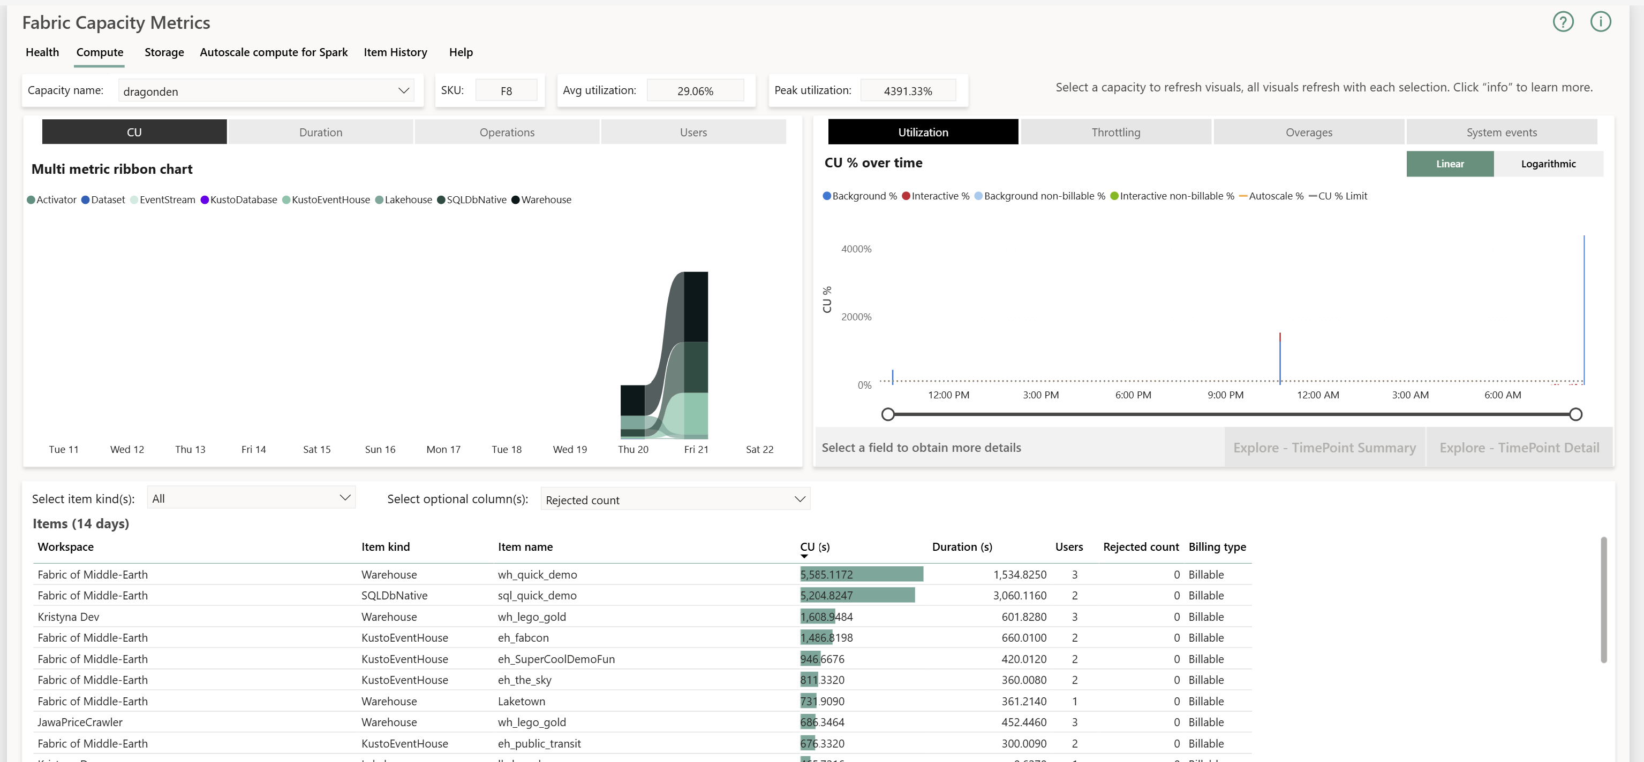
Your Primary Weapon
SWORN DEFENDER
Capacity Metrics App
Deep dive into CU consumption patterns
See which items consume the most capacity
Identify throttling and overage events
Understand consumption by operation type
Install this first - it's free and essential
Notes:
The Capacity Metrics App is your primary weapon as a Sworn Defender.
It's free, it's from Microsoft, and it gives you the detailed consumption data you need.
You can see which semantic models, which dataflows, which operations are consuming the most.
If you haven't installed it yet, that's your number one action item.

Slide 19
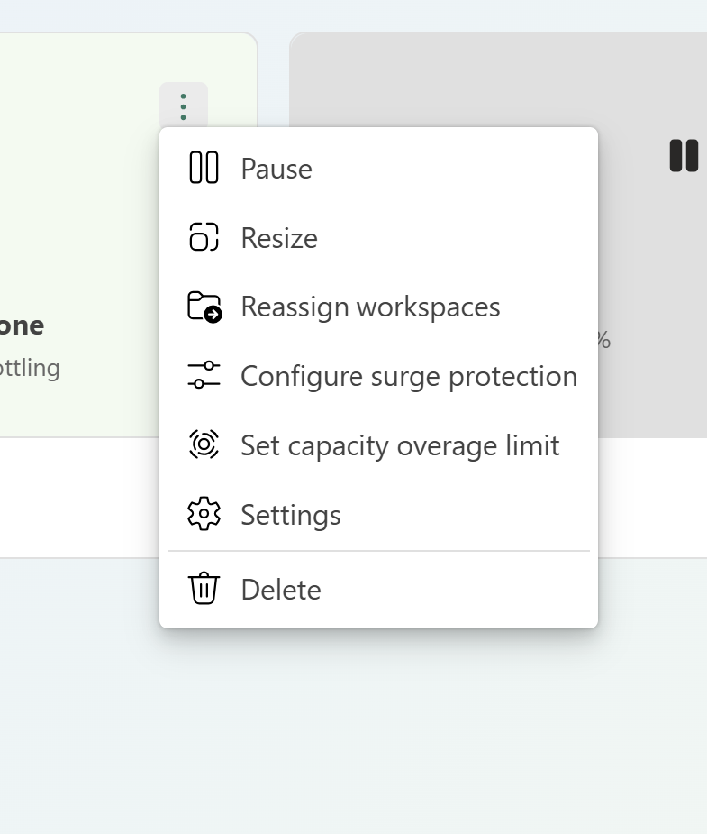
Your NEW Weapon
SWORN DEFENDER
Monitoring Hub (in preview)
Quickly see what capacities are on
Identify if any are in trouble
Resize the capacity
Set limits
No install needed! But, it is in preview. Expect changes.

Slide 20
Your Castle Walls
SWORN DEFENDER
FUAM: Fabric Unified Admin Monitoring
Pros
What It Does
Comprehensive. Consolidates admin data in one place
Multiple query paths: DirectLake, SQL Endpoint, notebooks
Extensible and supports custom modules
Single source of truth for Fabric admin monitoring
Tracks tenant settings, activity logs, workspaces, capacities, CU utilization
Modular and extensible. You can add custom data sources
100% Fabric-native (pipelines, notebooks, DirectLake reports)
Long-term CU utilization tracking for capacity planning
Cons
Depends on Capacity Metrics App internals which can break with updates
Some features still "coming soon"
No formal support except through GitHub issues
API fragility risk
Notes:
FUAM is the Fabric Unified Admin Monitoring solution from Microsoft's fabric-toolbox repo.
It's community-supported, not an official product, but it's powerful.
It pulls together tenant settings, activity logs, workspaces, capacities, and CU utilization into a single lakehouse with DirectLake reports on top.
The big value: it gives you long-term CU tracking that the Capacity Metrics App alone doesn't provide.
The risk: it depends on Capacity Metrics App internals that can change, and some features are still listed as coming soon.
Worth the investment if you want a unified admin view.
NOTE takes about 90 minutes to set up and you need a lot of credentials to do so.
fabric-toolbox/monitoring/fabric-unified-admin-monitoring/how-to/How_to_deploy_FUAM.md at main · microsoft/fabric-toolbox · GitHub

Slide 21
Heavy Artillery
SWORN DEFENDER
Fabric Platform Monitoring
Capacity Events
Activity Logs
Gateway Monitoring
Tenant Inventory
Near-real-time
via Eventstreams
Scheduled notebooks
hitting Activity API
PowerShell scripts
on each gateway
REST API pulls for
capacities & apps
Pros
Cons
Near-real-time capacity monitoring
Retains activity logs beyond 30-day default
Consolidates four data sources in one Eventhouse
Requires F8+ capacity (F16 recommended) which is a higher cost floor
Capacity Events still in Public Preview which means breaking changes possible
Complex setup: Service Principal, Key Vault, tenant admin config
No VNet gateway support
Notes:
Fabric Platform Monitoring is the most comprehensive of the three - it pulls from four different data sources into a single Eventhouse using KQL.
You get near-real-time capacity monitoring via Eventstreams, activity logs with retention beyond 30 days, on-prem gateway monitoring, and tenant inventory.
The catch: it needs F8 capacity minimum, F16 recommended, which is the highest cost floor.
Setup involves a Service Principal, Key Vault, and tenant admin configuration.
And the capacity events feature it depends on is still in public preview.
This is the heavy artillery! Powerful, but make sure you're ready for the setup investment.

Slide 22
Treasurer
SWORN DEFENDER
Fabric Cost Analysis
What It Does
Pros
Monitors and visualizes Fabric spending patterns
Reservation efficiency and capacity utilization
Uses FOCUS billing standard (portable, well-structured)
Includes FinOps maturity score
Natural-language Data Agent for ad-hoc cost queries
Lightweight: ~2% of F4 capacity
Fully Fabric-native (pipelines, notebooks, DirectLake)
Covers reservations, quotas, and FinOps maturity
Cons
Only covers Fabric costs, not broader Azure
Requires Fabric capacity to monitor Fabric capacity
Not a one-click install. Multi-step setup
No formal support
Notes:
Fabric Cost Analysis follows the money.
It pulls from Azure Cost Management using the FOCUS billing standard and visualizes your Fabric spending (reservation efficiency, capacity utilization, cost trends).
It even includes a FinOps maturity score and a natural-language Data Agent for ad-hoc cost questions.
The lightweight footprint is a real selling point. Only consumes roughly 2% of an F4 capacity.
The limitation: it only covers Fabric costs, not broader Azure, so it's a complement to your Azure cost management, not a replacement.
Great for the admin who needs to have budget conversations with leadership.

Slide 23




Staying Ahead
SWORN DEFENDER
Monitor Consumption Trends
Know Your Peak Windows
Spot patterns over weeks, not days
Schedule heavy work outside them
Right-Size Your SKU
Scale Up vs. Optimize
Don't overpay, don't under-provision
Sometimes better queries beat bigger capacity
Notes:
Having the tools is one thing using them strategically is what makes you a Sworn Defender.
Track consumption trends over weeks. Know when your tenant is busiest.
Have an honest conversation about SKU sizing versus workload optimization.

Slide 24

Demo time!
SWORN DEFENDER
Capacity Monitoring Walkthrough
FUAM Walkthrough
Where to find these tools
Notes:
fabric-toolbox/monitoring/fabric-unified-admin-monitoring at main · microsoft/fabric-toolbox · GitHub

Slide 25
Forge the Defenses
REALM PROTECTOR
You don't wait for the dragon.
You fireproof the village.
1
Notebook Guardrails
Automatically cancel runaway refreshes before they exhaust capacity
2
Capacity Data Capture
Pull Capacity Metrics data into notebooks for trend & cost analysis
Notes:
Welcome to the highest tier.
The Realm Protector doesn't wait for problems.
They build the defenses before the attack.
Two powerful plays: notebook guardrails that automatically cancel runaway refreshes, and notebooks that capture capacity data over time for cost trend analysis.

Slide 26

Kill Runaway Refreshes Automatically
REALM PROTECTOR
If a refresh exceeds X minutes, cancel it — no human required
1
2
3
4
Query
Threshold
Act
Schedule
Pull refresh status
via REST APIs
Compare against
your limits
Cancel operations
that breach
Run on a
recurring interval
Notes:
Your notebook queries running operations through the REST APIs, compares them against your thresholds, and cancels operations that breach limits.
Schedule it every 60 minutes and you've got an automated guardrail. The dragon gets stopped at the gate.

Slide 27
Capture Your Costs
REALM PROTECTOR
Use a notebook to pull Capacity Metrics App data regularly
Store historical data for trend analysis
Spot cost creep before it hits your budget
Build long-term consumption visibility
Turn reactive cost surprises into proactive budget conversations
Notes:
The Capacity Metrics App shows what's happening now but doesn't give you long-term trend data out of the box.
By capturing that data regularly via notebooks, you build a historical record.
Cost trends over months, workloads slowly consuming more, proactive budget conversations before surprises.

Slide 28

Demo time!
REALM PROTECTOR
Custom notebook example of a pro-active capacity saver
Custom notebook example to capture Capacity Metrics in a lakehouse
Notes:
fabric-toolbox/monitoring/fabric-unified-admin-monitoring at main · microsoft/fabric-toolbox · GitHub

Slide 29
Start This Week!
TORCHBEARER
SWORN DEFENDER
REALM PROTECTOR
Audit critical tenant settings (the red zone)
Tour the admin portal & know where things live
Understand your capacity SKU and what you're paying for
Install the Capacity Metrics App
Set up FUAM for activity tracking
Identify your top 5 capacity consumers
Build your first guardrail notebook (steal from mine!)
Set up capacity data capture for trending
Establish a capacity review cadence
Notes:
Find yourself on this path and start there. Even one step forward makes your tenant healthier.

Slide 30

Key Takeaways
1
Light the torch first: you can't defend what you can't see
2
Pick up your weapons: Capacity Metrics + FUAM give you the full picture
3
Fireproof the village: guardrails before dashboards, prevention before reaction
4
Every tier matters: the torchbearer is just as essential as the protector

Slide 31

Don’t forget to connect, thanks for listening!
https://dataonwheels.wordpress.com/
kristyna@dataonwheels.com
@data_dragoness
GitHub

